Slide 1

Pollen's Profiling: Automated Classification of Pollen Grains
Team ID:LTVIP2025TMID36397

Slide 2

Introduction & Problem
Pollen's Profiling automates pollen grain classification using deep learning. Traditionally, this task is time-consuming and prone to human error, relying on expert observation through microscopes. Our solution leverages Convolutional Neural Networks (CNNs) to classify pollen into 23 distinct classes with high accuracy.

Slide 3



Empathy Mapping: User Pain Points
Researcher
Student
Lab Assistant
"It takes hours to sort images."
"How do I identify this?"
"Results differ every time."
Feels frustrated.
Feels confused.
Feels insecure.

Slide 4
Proposed Solution: CNN & Flask Web App
Our solution is a Flask web application that allows users to upload pollen images. These images are then classified using a CNN model trained on 23 pollen classes, with predictions and confidence levels displayed instantly.
Key Features
Non-Functional Requirements
Image Upload Interface
Usability: Clean interface
Classification & Prediction
Security: Input validation
Result Output Display
Reliability: Consistent outputs
Performance: 2-4 second classification

Slide 5
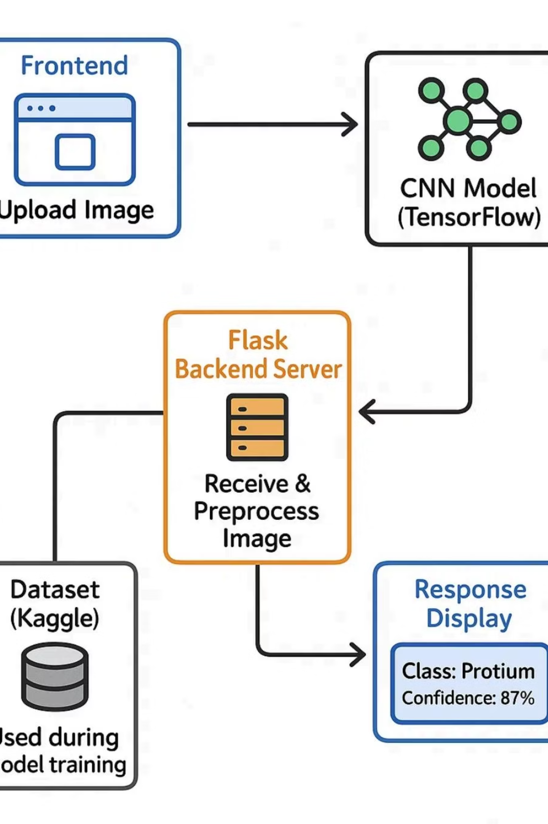
Architecture Diagram
The system processes uploaded images through a CNN model, returning classified results to the user interface.

Slide 6
Project Planning & Scheduling
User
Upload Image
USN-1
Create HTML form
Sprint-1
User
Prediction Display
USN-2
Return & show prediction
Sprint-1
Admin
Log Monitoring
USN-3
View prediction logs
Sprint-2

Slide 7
Testing & Results
Performance Metrics
Key Outcomes
Accuracy: 87.6%
User uploads image
Loss Value: ~0.707
CNN classifies into 1 of 23 classes
Average Inference Time: ~2.8 seconds
UI shows pollen name and confidence
Supports consistent scientific workflows

Slide 8
Conclusion & Future Scope
Advantages
Future Plans
Fast and scalable
Mobile integration
User-friendly interface
Dataset expansion
Model explainability via score
Real-time microscope image feeds
Transfer learning upgrades
This project effectively uses deep learning for ecological and biological classification, reducing human dependency and improving consistency.

